Slide 1





Modelling Coach Decisions in Professional Cycling Teams
$${\text{Maor} \text{Sagi}}^{1}$$
$${\text{Paulo} \text{Saldanha}}^{2}$$
$$\text{Prof}\text{. }\text{Guy} {\text{Shani}}^{1}$$
$${\text{Prof}\text{. }\text{Robert} \text{Moskovitch}}^{1}$$
¹Software and Information Systems Engineering
²Israel – Premier Tech
Machine Learning and Data Mining for Sports Analytics Workshop 2022
Notes:
Paulo – performance director
Faculty member

Slide 2
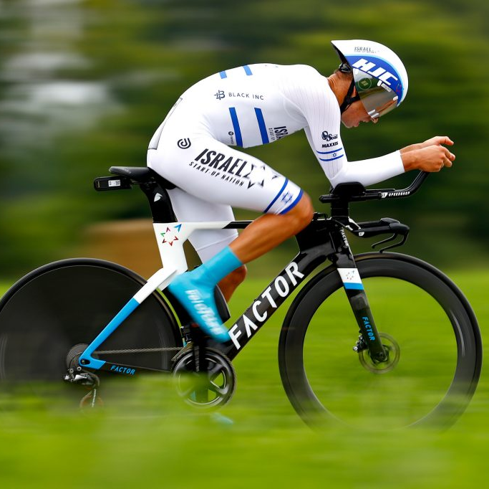
Agenda
Introduction
Related Works
RaceFit
Evaluation
Summary

Slide 3
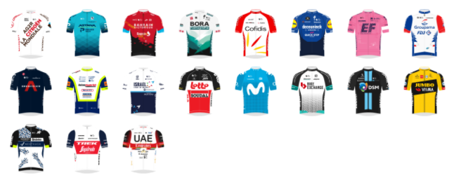



Introduction – pro cycling
18 UCI World teams, 17 UCI Pro teams, 18-34 cyclists in each team
Around 100 races per year, in which 8 cyclists race from each team
Grand Tours – stage races, 21 days, i.e., Tour de France
Major Tours – stage races, multiple days, i.e., Paris-Nice
One day races – i.e., Paris-Roubaix
Israel – Premier Tech (IPT)
Foundation of Israel Cycling Academy in 2014.
In 2020 – team granted a UCI World Tour license.
Notes:
Union Cycliste Internationale (UCI) - International Cycling Union
UCI WorldTeams competes in the UCI World Tour, cycling team of the highest category in professional road cycling
Teams (3 Tiers): (sorted from highest to lowest)
WorldTeams WT: There will be 19 WT teams in 2020.
ProTeams PT (ProContinental Teams). Well also have 19 PT teams in 2020.
Continental Teams CT. There are probably somewhere between 100 and 200 CT teams world wide.
Races (4 Tiers): (sorted from highest to lowest)
Races are always denoted like this: "Type.Category" (like "1.PT") The Type describes wheter the races is a oneday race (1) or stage race (2). The categories are the following:
.WT: WorldTour Races: In most of these races (with a few exceptions) all WT teams have to participate. They will also give out wildcards to PT teams. CT teams are not allowed here. Thus they are the post prestigous races.
.PT: ProTour Races (HC Races). Here WT teams (in some races more than in others) mix with PT teams and a few CT teams.
.1: These are smaller races with a really limited number of WT teams, sometimes none, but more PT and alot of CT teams.
.2: These are rather amateur races with only CT teams and local elite teams (with no UCI license)
https://www.reddit.com/r/peloton/comments/ejfc4r/worldtour_vs_protour_can_someone_help_me/

Slide 4



Data Sources in Pro Cycling
Pro Cycling Stats (PCS) – Cycling statistics website
Containing: races’ properties, results, teams, cyclists…
Training Peaks (TP) – Training tracking and Coaching services
Including: workouts info, i.e., distance, duration, power, cadence, heart rate...
STRAVA – fitness tracking and social media app
Including: workouts info, i.e., distance, duration, power, cadence, heart rate...
Notes:
Note – In the paper we present IPT Training Peaks data only. We are working of many teams data now.

Slide 5
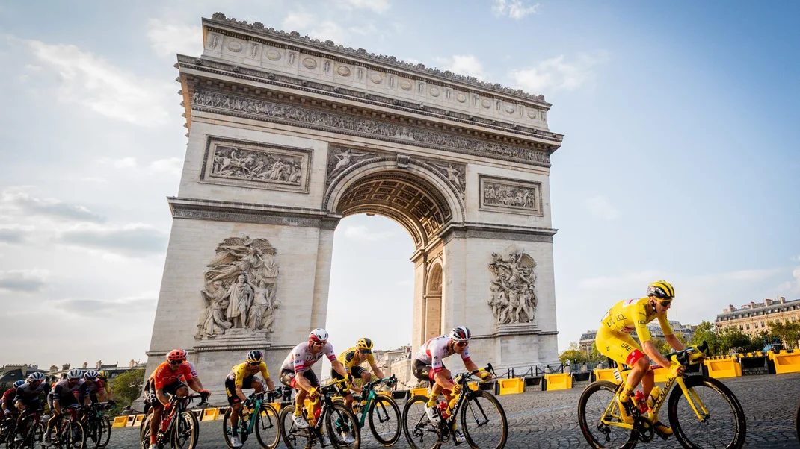
Cyclists’ allocation in Races - Problem Formulation
Using races info (from PCS) and workouts (TP or STRAVA) data –
Learn the cyclists’ allocation to races decision process of a team
Analyze decision factors of cyclists’ allocation to races
Notes:
Motivation-
Rank Cyclists to race for each specific race is time consuming task, and hard to determine based on evidence (data).
Coaches go over and analyze a lot of data and pick the best collection of cyclists for a specific race.
The decision depends on a vast number of parameters.
Todays solution – working with dashboard and track cyclists workouts performance and stages to race with many properties

Slide 6
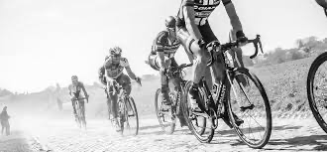
Related Works
Forecasting cyclists’ outcomes in races
Kholkine, Leonid, et al. A Learn-to-Rank Approach for Predicting Road Cycling Race Outcomes. Frontiers in sports and active living 3 (2021).‏
Van Bulck, David, Arthur Vande Weghe, and Dries Goossens. Result-based talent identification in road cycling: discovering the next Eddy Merckx. Annals of Operations Research (2021): 1-18.‏
Notes:
Kholkine, Leonid, et al. A Learn-to-Rank Approach for Predicting Road Cycling Race Outcomes. Frontiers in sports and active living 3 (2021).‏
ML model prediction of top 10 cyclists in races results
Use data from PCS website
Riders’ data
Historical results of the rider
The PCS points of the rider
Train data from 2000-2017
Test data 2018-2019
One day races
Van Bulck, David, Arthur Vande Weghe, and Dries Goossens. Result-based talent identification in road cycling: discovering the next Eddy Merckx. Annals of Operations Research (2021): 1-18.‏
Detection of new talented riders under 23 years old
Data from PCS and CQ websites:
Riders’ rankings & points
Races data
Predict the performance (UCI points)
Data 2007-2018

Slide 7
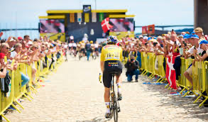
Related Works
Prediction of cyclist‘s power performance in races
Leeuw, Arie-Willem de, et al. Time series regression in professional road cycling. International Conference on Discovery Science. Springer, Cham, 2020.‏
Kataoka, Yasuyuki, and Peter Gray. Real-time power performance prediction in tour de France. International workshop on machine learning and data mining for sports analytics. Springer, Cham, 2018.‏
Notes:
Leeuw, Arie-Willem de, et al. Time series regression in professional road cycling. International Conference on Discovery Science. Springer, Cham, 2020.‏
ML model prediction of cyclist’s power performance In Tour de France
Data -
Performance of single rider during several years.
Physical measurements, temp., altitude, speed, distance (cycling computer)
Stages profiles and additional data – 150 stages
Kataoka, Yasuyuki, and Peter Gray. Real-time power performance prediction in tour de France. International workshop on machine learning and data mining for sports analytics. Springer, Cham, 2018.‏
ML model prediction of performance of cyclist in future race
Data -
Single race – Tour the France 2017
GPS to extract features & environmental conditions like wind direction and speed
Position in group feature
Power sensor data - labels

Slide 8
Cycling Teams’ Races and Workouts Dataset
583 Cyclists from 10 teams
Age, weight, height, cyclist’s statistics and specialties (i.e., sprint, climbing)
1025 Races, 3100 Stages during 2017-2022
Race classification, distance, elevation gain, results and rankings
65k Training Peaks Workouts of 37 cyclists during 2017-2022
302k STRAVA Workouts of 364 cyclists during 2017-2022
Workout’s duration, distance, elevation gain, calories, power, speed, heart rate, temperature, cadence, etc.
Notes:
TP data – upload all trainings
STRAVA – upload some, some accounts are private.

Slide 9


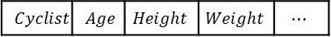

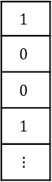
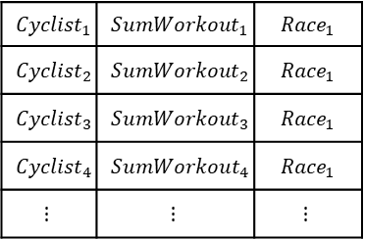
RaceFit - Classification based Ranking Method Training Phase
Race vector
Cyclists’ Ranker
$$Race$$ | $$Distance$$ | $$Elevation Gain$$ | $$Temperature$$ | $$⋯$$
Participated or not
Races
Examples
Label
$${Cyclist}_{1}$$ | $${SumWorkout}_{1}$$ | $${Race}_{1}$$
$${Cyclist}_{2}$$ | $${SumWorkout}_{2}$$ | $${Race}_{1}$$
$${Cyclist}_{3}$$ | $${SumWorkout}_{3}$$ | $${Race}_{1}$$
$${Cyclist}_{4}$$ | $$Sum{Workout}_{4}$$ | $${Race}_{1}$$
$$⋮$$ | $$⋮$$ | $$⋮$$
$$1$$
$$0$$
$$0$$
$$1$$
$$⋮$$
Cyclist vector
$$Cyclist$$ | $$Age$$ | $$Height$$ | $$Weight$$ | $$⋯$$
Features
Filtering
&
Imputation
Classifier
Cyclists
Summarized Workouts vector
For each team cyclist in each race
$$SumWorkout$$ | $$Distance$$ | $$Duration$$ | $$Calories$$ | $$⋯$$
Workouts
Workouts Time Window
Time
$${Race}_{i}$$
Notes:
Important note – using cyclists that didn’t participate data

Slide 10
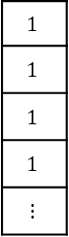
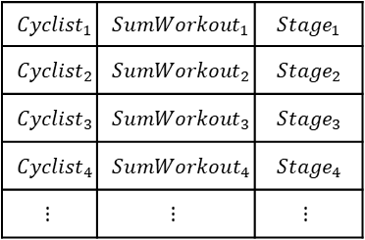
RaceFit - Classification based Ranking Method Training Phase
Stage vector
Cyclists’ Ranker
$$Stage$$ | $$Distance$$ | $$Elevation Gain$$ | $$Temperature$$ | $$⋯$$
Participated or not
Stages
Examples
Label
$${Cyclist}_{1}$$ | $${SumWorkout}_{1}$$ | $${Stage}_{1}$$
$${Cyclist}_{2}$$ | $${SumWorkout}_{2}$$ | $${Stage}_{2}$$
$${Cyclist}_{3}$$ | $${SumWorkout}_{3}$$ | $${Stage}_{3}$$
$${Cyclist}_{4}$$ | $$Sum{Workout}_{4}$$ | $$Stage_{4}$$
$$⋮$$ | $$⋮$$ | $$⋮$$
$$1$$
$$1$$
$$1$$
$$1$$
$$⋮$$
Cyclist vector
$$Cyclist$$ | $$Age$$ | $$Height$$ | $$Weight$$ | $$⋯$$
Cyclists
Classifier
Features
Filtering
&
Imputation
Summarized Workouts vector
$$SumWorkout$$ | $$Distance$$ | $$Duration$$ | $$Calories$$ | $$⋯$$
Workouts
For each team cyclist in each race
Workouts Time Window
Time
$${Race}_{i}$$
Notes:
Important note – using cyclists that didn’t participate data

Slide 11
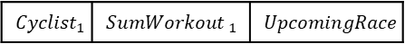
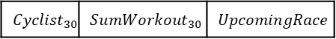
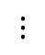
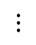
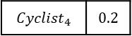
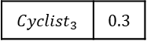
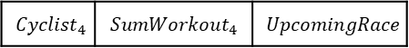
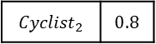
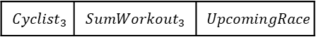
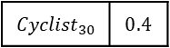
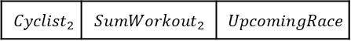
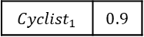
RaceFit - Classification based Ranking Method Recommendation Phase
Cyclists Matching Scores
For each team cyclist
Upcoming race vector
Cyclists’ Ranker
$$Race$$ | $$Distance$$ | $$Elevation Gain$$ | $$Temperature$$ | $$⋯$$
$${Cyclist}_{1}$$ | $${SumWorkout }_{1}$$ | $$UpcomingRace$$
$${Cyclist}_{1}$$ | $$0.9$$
Races
$${Cyclist}_{2}$$ | $${SumWorkout}_{2}$$ | $$UpcomingRace$$
$${Cyclist}_{2}$$ | $$0.8$$
Cyclist vector
$${Cyclist}_{3}$$ | $${SumWorkout}_{3}$$ | $$UpcomingRace$$
$${Cyclist}_{3}$$ | $$0.3$$
$$Cyclist$$ | $$Age$$ | $$Height$$ | $$Weight$$ | $$⋯$$
$$Cyclist$$ | $$Age$$ | $$Height$$ | $$Weight$$ | $$⋯$$
$${Cyclist}_{4}$$ | $${SumWorkout}_{4}$$ | $$UpcomingRace$$
$${Cyclist}_{4}$$ | $$0.2$$
Cyclists
Classifier
$$⋮$$
$$⋮$$
Summarized Workouts vector
$${Cyclist}_{30}$$ | $${SumWorkout}_{30}$$ | $$UpcomingRace$$
$${Cyclist}_{30}$$ | $$0.4$$
$$SumWorkout$$ | $$Distance$$ | $$Duration$$ | $$Calories$$ | $$⋯$$
Features
Filtering
&
Imputation
Workouts
Workouts Time Window
Time
$${Race}_{i}$$
Notes:
To explain – insert all team cyclists (let’s say 30)

Slide 12
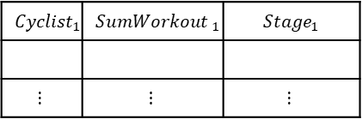

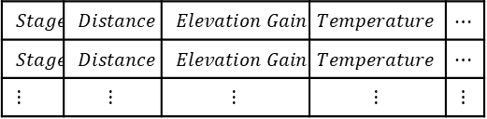
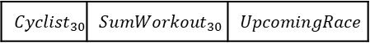
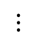
RaceFit - Classification based Ranking Method Recommendation Phase
Cyclists Matching Scores
For each team cyclist
Upcoming race stages vectors
Cyclists’ Ranker
$$Stage$$ | $$Distance$$ | $$Elevation Gain$$ | $$Temperature$$ | $$⋯$$
$$Stage$$ | $$Distance$$ | $$Elevation Gain$$ | $$Temperature$$ | $$⋯$$
$$⋮$$ | $$⋮$$ | $$⋮$$ | $$⋮$$ | $$⋮$$
$${Cyclist}_{1}$$ | $${SumWorkout }_{1}$$ | $$Stage_{1}$$
$$⋮$$ | $$⋮$$ | $$⋮$$
$${Cyclist}_{1}$$ | $$0.9$$
Races
$${Cyclist}_{2}$$ | $$0.8$$
$$×$$
Cyclist vector
$$Cyclist$$ | $$Age$$ | $$Height$$ | $$Weight$$ | $$⋯$$
$$Cyclist$$ | $$Age$$ | $$Height$$ | $$Weight$$ | $$⋯$$
Cyclists
Classifier
$$⋮$$
Summarized Workouts vector
$$⋮$$
$${Cyclist}_{30}$$ | $$0.4$$
$$SumWorkout$$ | $$Distance$$ | $$Duration$$ | $$Calories$$ | $$⋯$$
Features
Filtering
&
Imputation
$${Cyclist}_{30}$$ | $${SumWorkout}_{30}$$ | $$UpcomingRace$$
Workouts
Workouts Time Window
Time
$${Race}_{i}$$
Notes:
To explain – insert all team cyclists (let’s say 30)

Slide 13
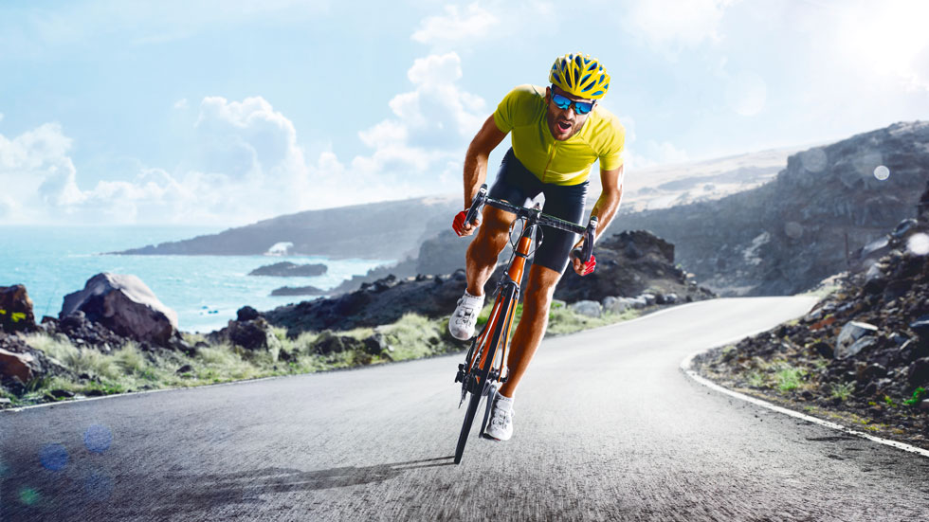
Evaluation Research Goals
Evaluate the performance of the RaceFit modeling
Analyze which factors of the cyclists are most important
Notes:
We aould like to maximize the AUC
For all different thresholds the precision and recall score would be higher
For example – for 0.1 thresh (low) we would like to recommend largest portion of cyclist who raced
For 0.9 thresh (high) if we are so cautious the best thing is that the one we recommend for the very least would be actually raced
Easier to see on graph edges, we wold like to push the recall/precision to be higher (like the arrows direction)
These metrics are evaluating the precision and recall for specific number of cyclists recommended.
Precision and recall are most appropriate here because this is a one class predic- tion problem, i.e., we are only interested in correctly predicting which cyclists will participate in the race. While in many applications precision — the portion of correct predictions in the predicted list is most important, in this application the amount of correct predictions, cyclists that participate in the race, is very low, and hence recall seems more expressive. Moreover, it is likely that when the upcoming race re- quires n cyclists, the coach will ask the framework for at least n recommended cyclists, however, the coach typically will require additional k recommended cy- clists spare in case any of the top favored cyclists will not be able to participate. We hence also compute recall@(n + k) for k = 0, 1....

Slide 14
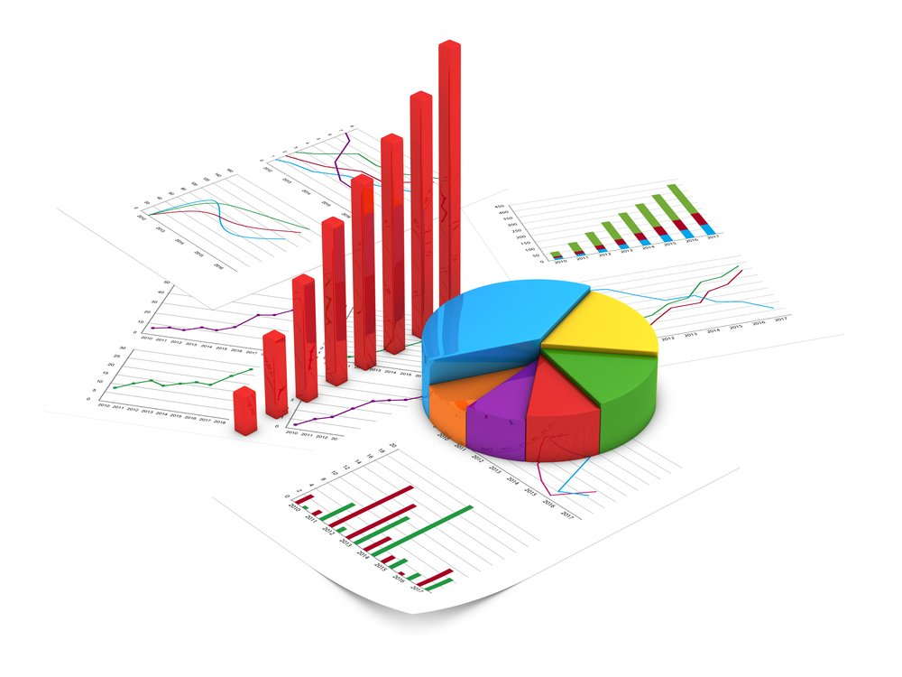
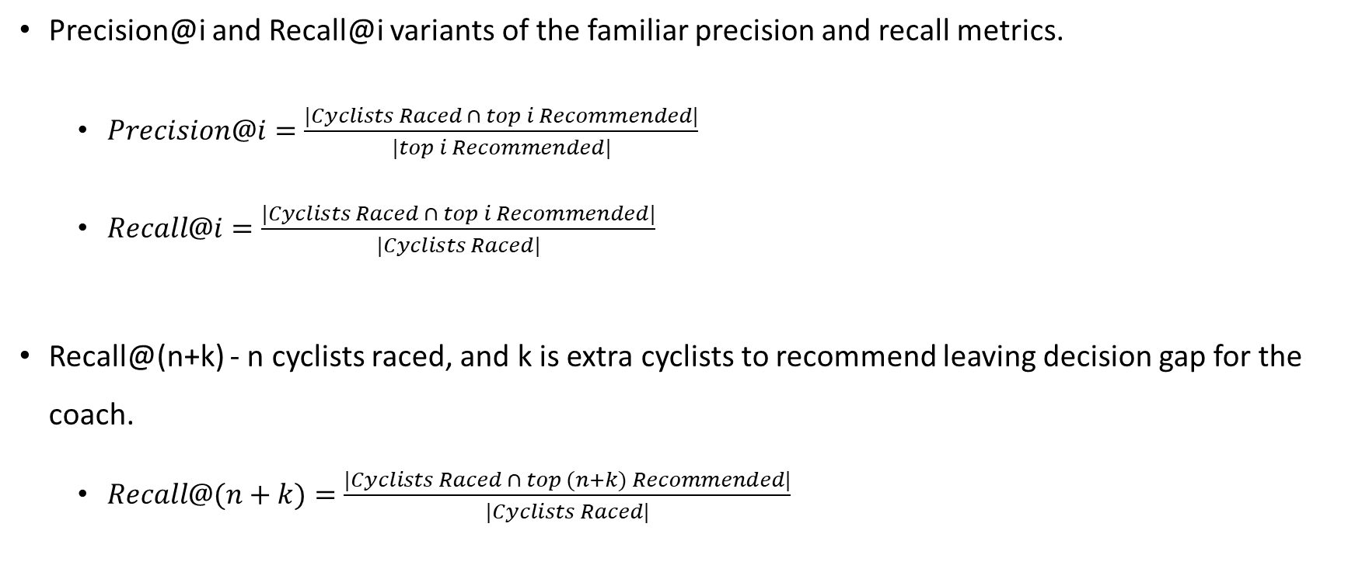
Evaluation Metrics
Precision@i and Recall@i variants of the familiar precision and recall metrics.
$Precision@i=\frac{|Cyclists Raced ∩ top i Recommended|}{|top i Recommended|}$
$Recall@i=\frac{|Cyclists Raced ∩ top i Recommended|}{|Cyclists Raced|}$
Recall@(n+k) - n cyclists raced, and k is extra cyclists to recommend leaving decision gap for the coach.
$Recall@(n+k)=\frac{|Cyclists Raced ∩ top (n+k) Recommended|}{|Cyclists Raced|}$
Notes:
We aould like to maximize the AUC
For all different thresholds the precision and recall score would be higher
For example – for 0.1 thresh (low) we would like to recommend largest portion of cyclist who raced
For 0.9 thresh (high) if we are so cautious the best thing is that the one we recommend for the very least would be actually raced
Easier to see on graph edges, we wold like to push the recall/precision to be higher (like the arrows direction)
These metrics are evaluating the precision and recall for specific number of cyclists recommended.
Precision and recall are most appropriate here because this is a one class predic- tion problem, i.e., we are only interested in correctly predicting which cyclists will participate in the race. While in many applications precision — the portion of correct predictions in the predicted list is most important, in this application the amount of correct predictions, cyclists that participate in the race, is very low, and hence recall seems more expressive. Moreover, it is likely that when the upcoming race re- quires n cyclists, the coach will ask the framework for at least n recommended cyclists, however, the coach typically will require additional k recommended cy- clists spare in case any of the top favored cyclists will not be able to participate. We hence also compute recall@(n + k) for k = 0, 1....

Slide 15
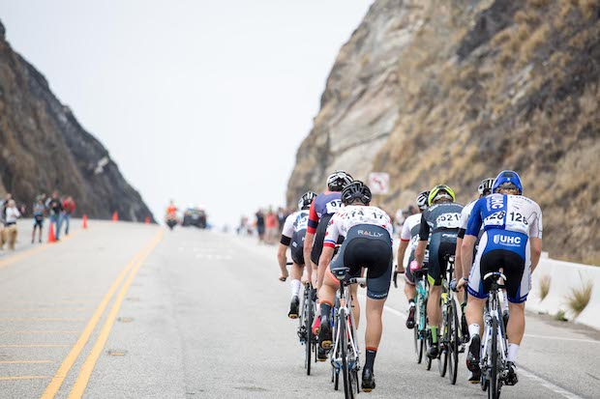
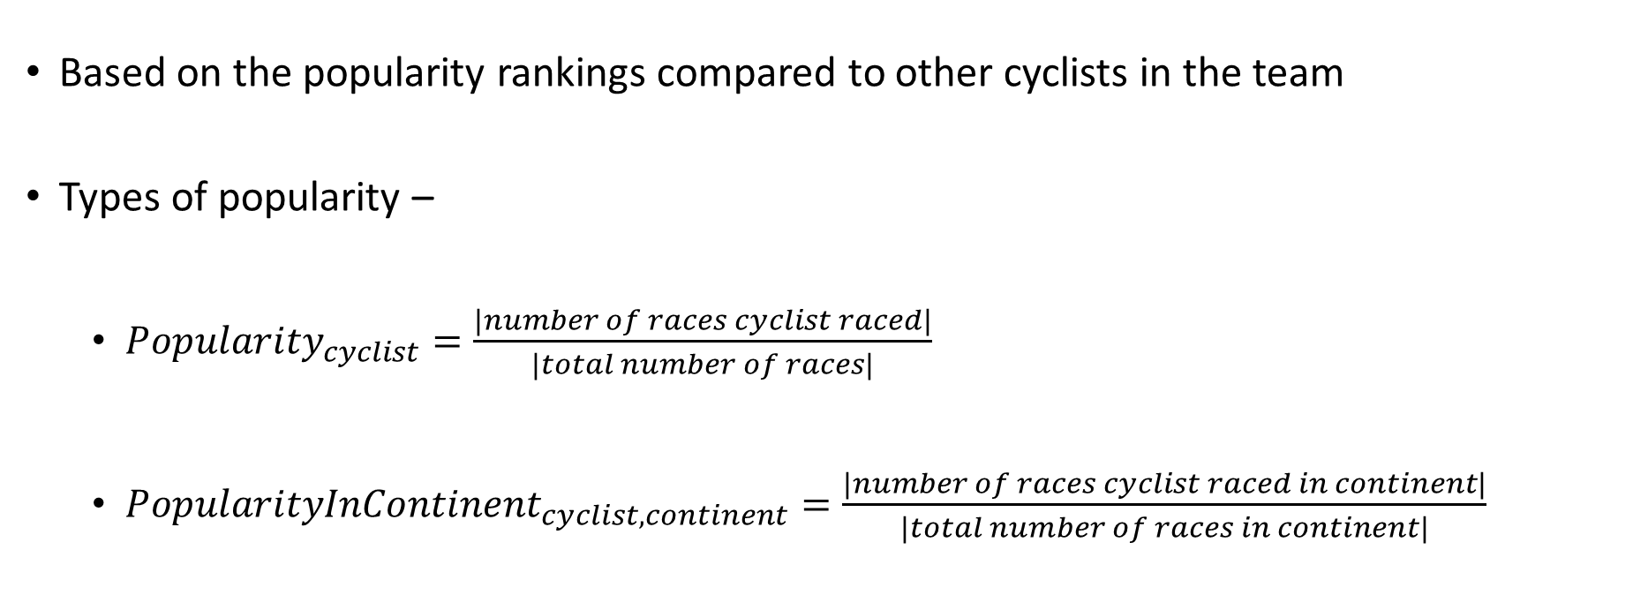
Evaluation – Popularity Baselines
Based on the popularity rankings compared to other cyclists in the team
Types of popularity –
${Popularity}_{cyclist}=\frac{|number of races cyclist raced|}{|total number of races|}$
$Popularity{InContinent}_{cyclist,continent}=\frac{|number of races cyclist raced in continent|}{|total number of races in continent|}$

Slide 16
Experimental Plan – Expr. 1
4 UCI World Teams –
Team | Workout Source
Israel - Premier Tech | TrainingPeaks and STRAVA
Jumbo-Visma | STRAVA
Groupama - FDJ | STRAVA
AG2R Citroën Team | STRAVA

Slide 17

Experimental Plan – Expr. 1
Data Imputation – without imputation, imputation with Simple Imputer
Classifiers - CatBoost, Decision Tree and Logistic Regression.
Experimental setup:
Time window size – 5 weeks.
Features missing values dropping ratio – 60%
Classifier
Workouts Time Window
Time
$${Race}_{i}$$

Slide 18
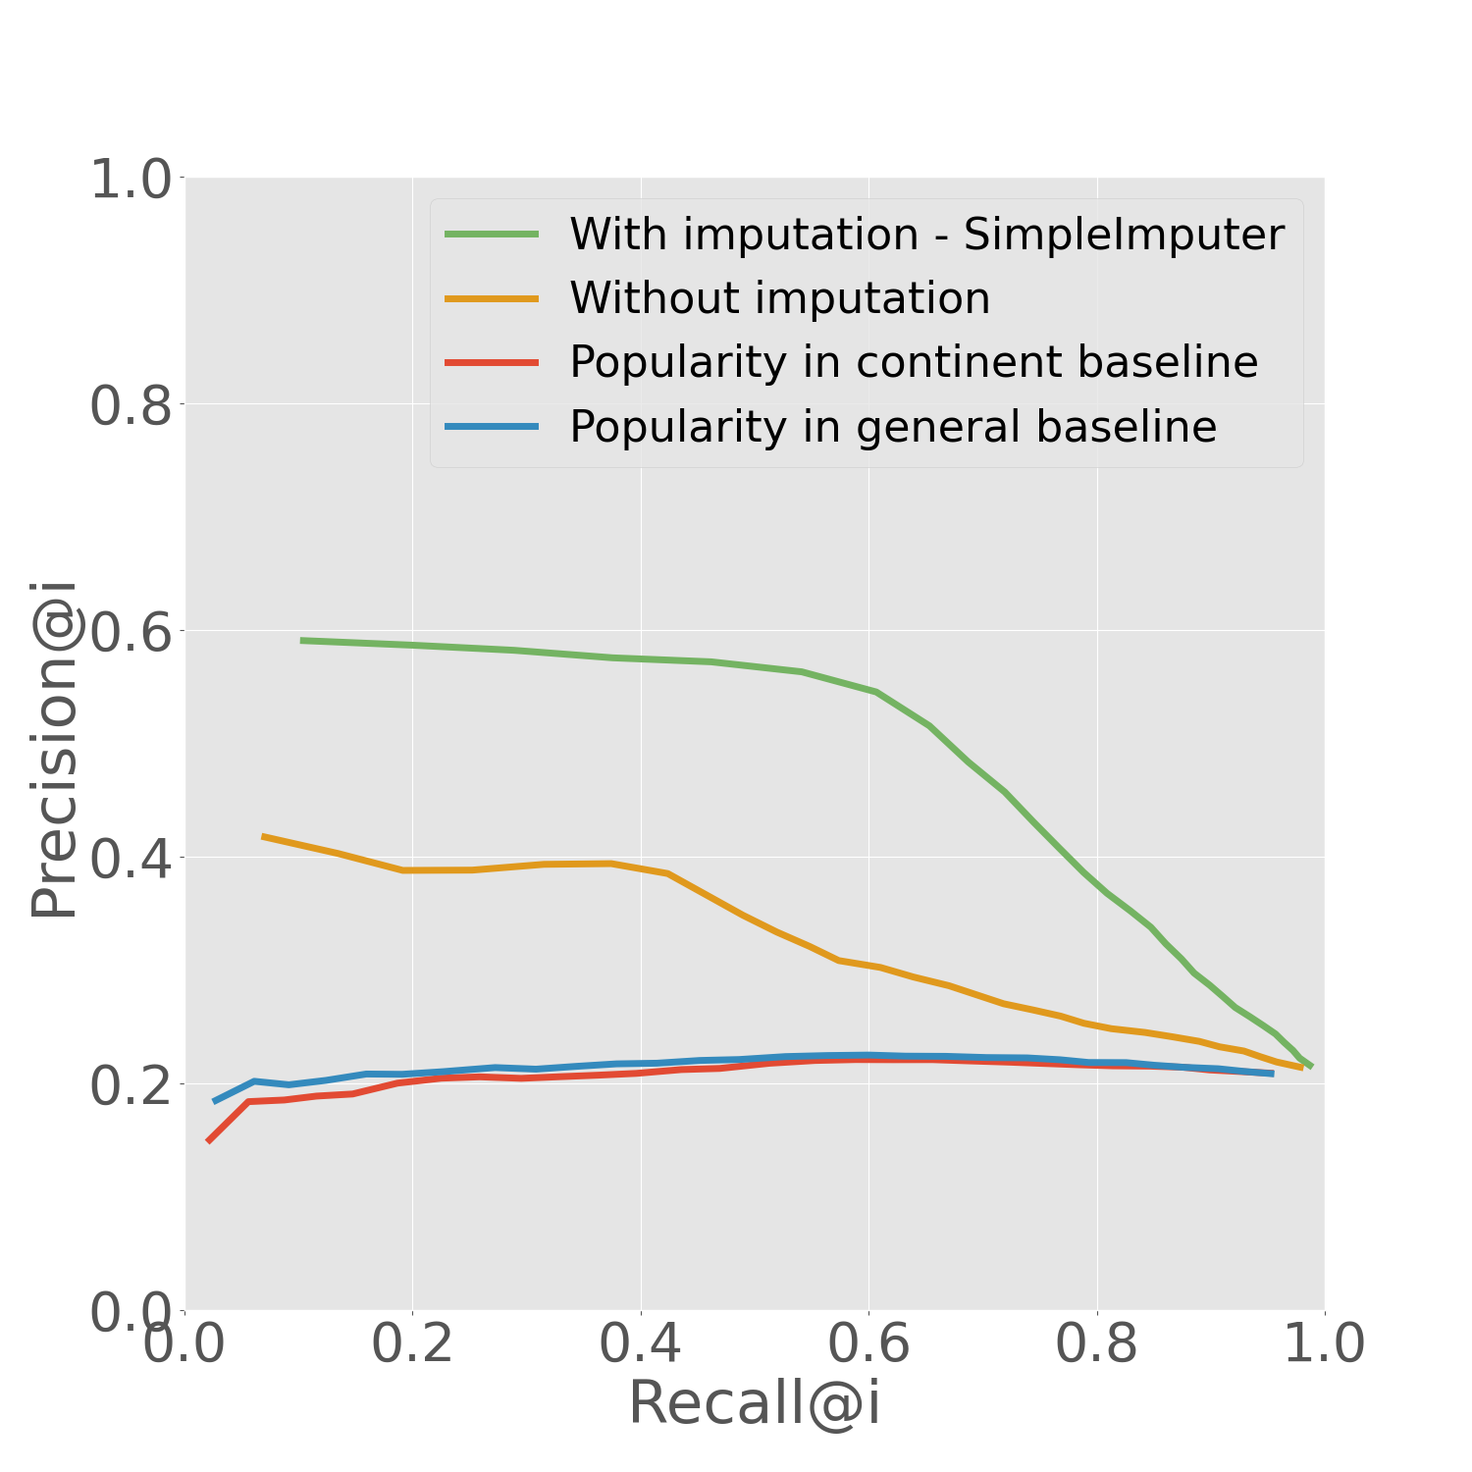
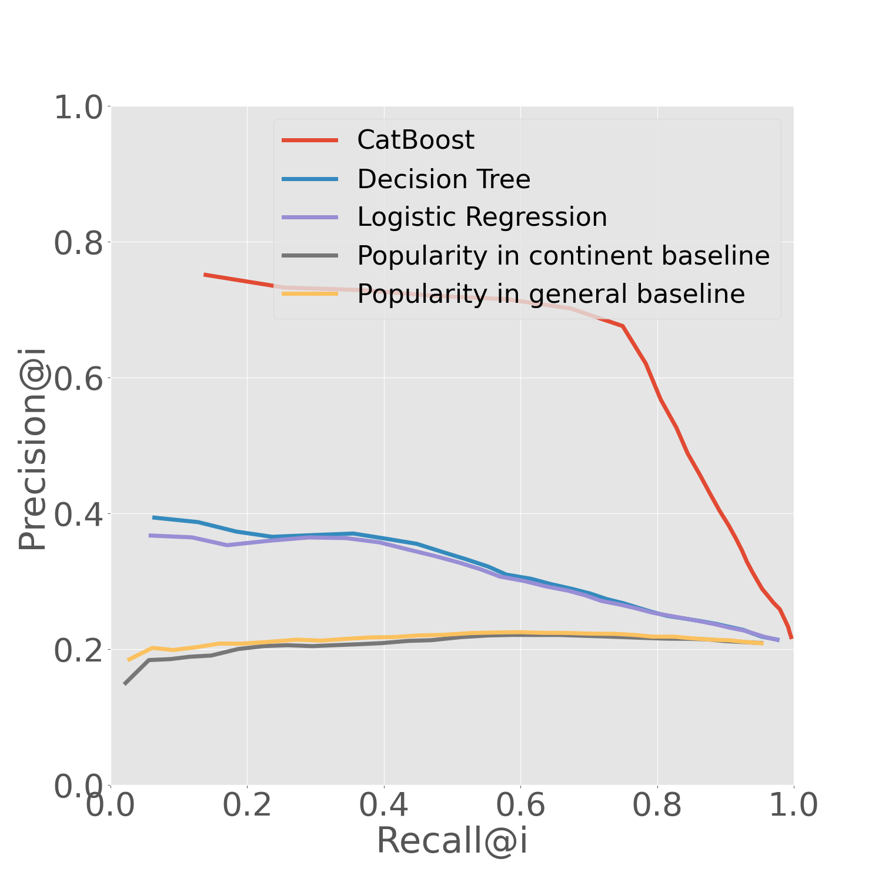
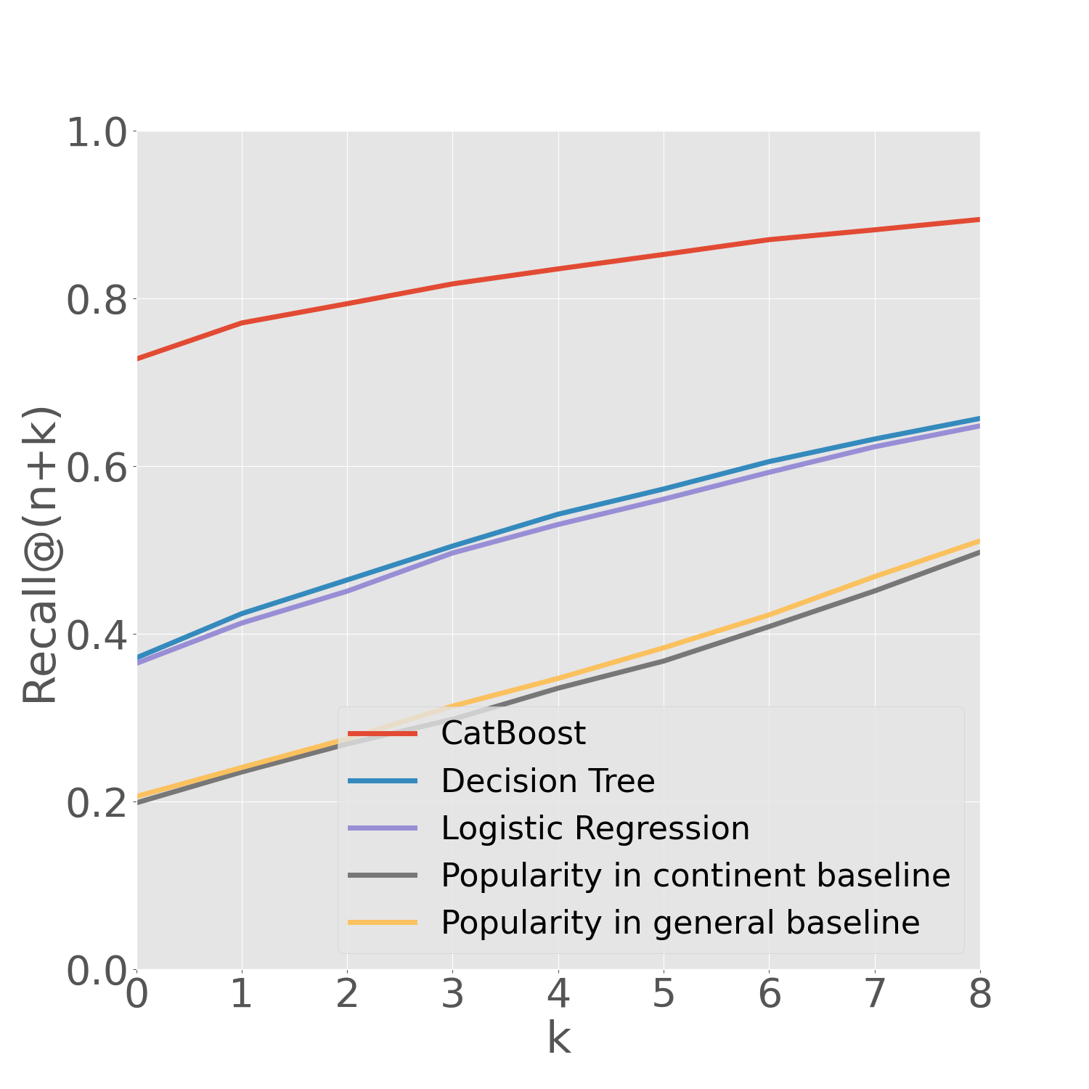
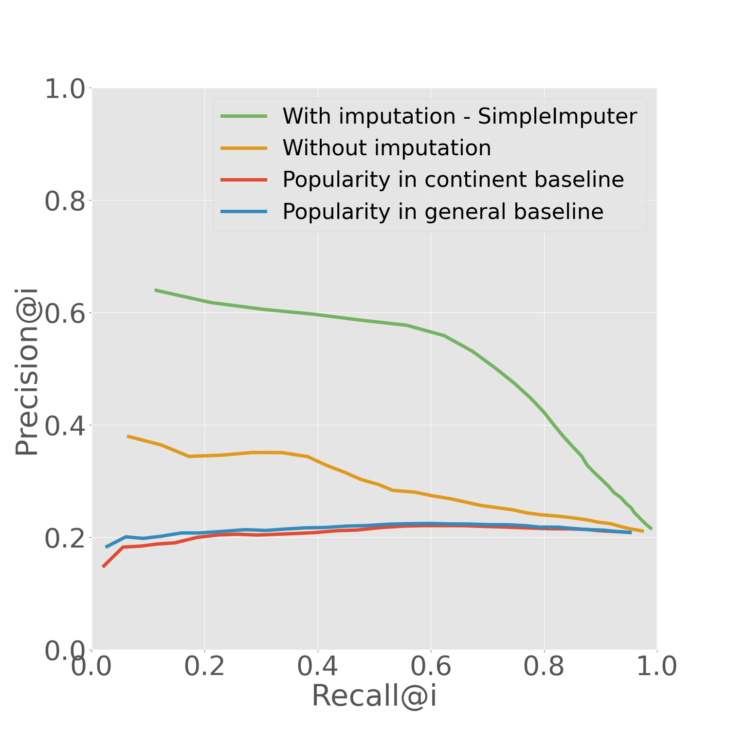
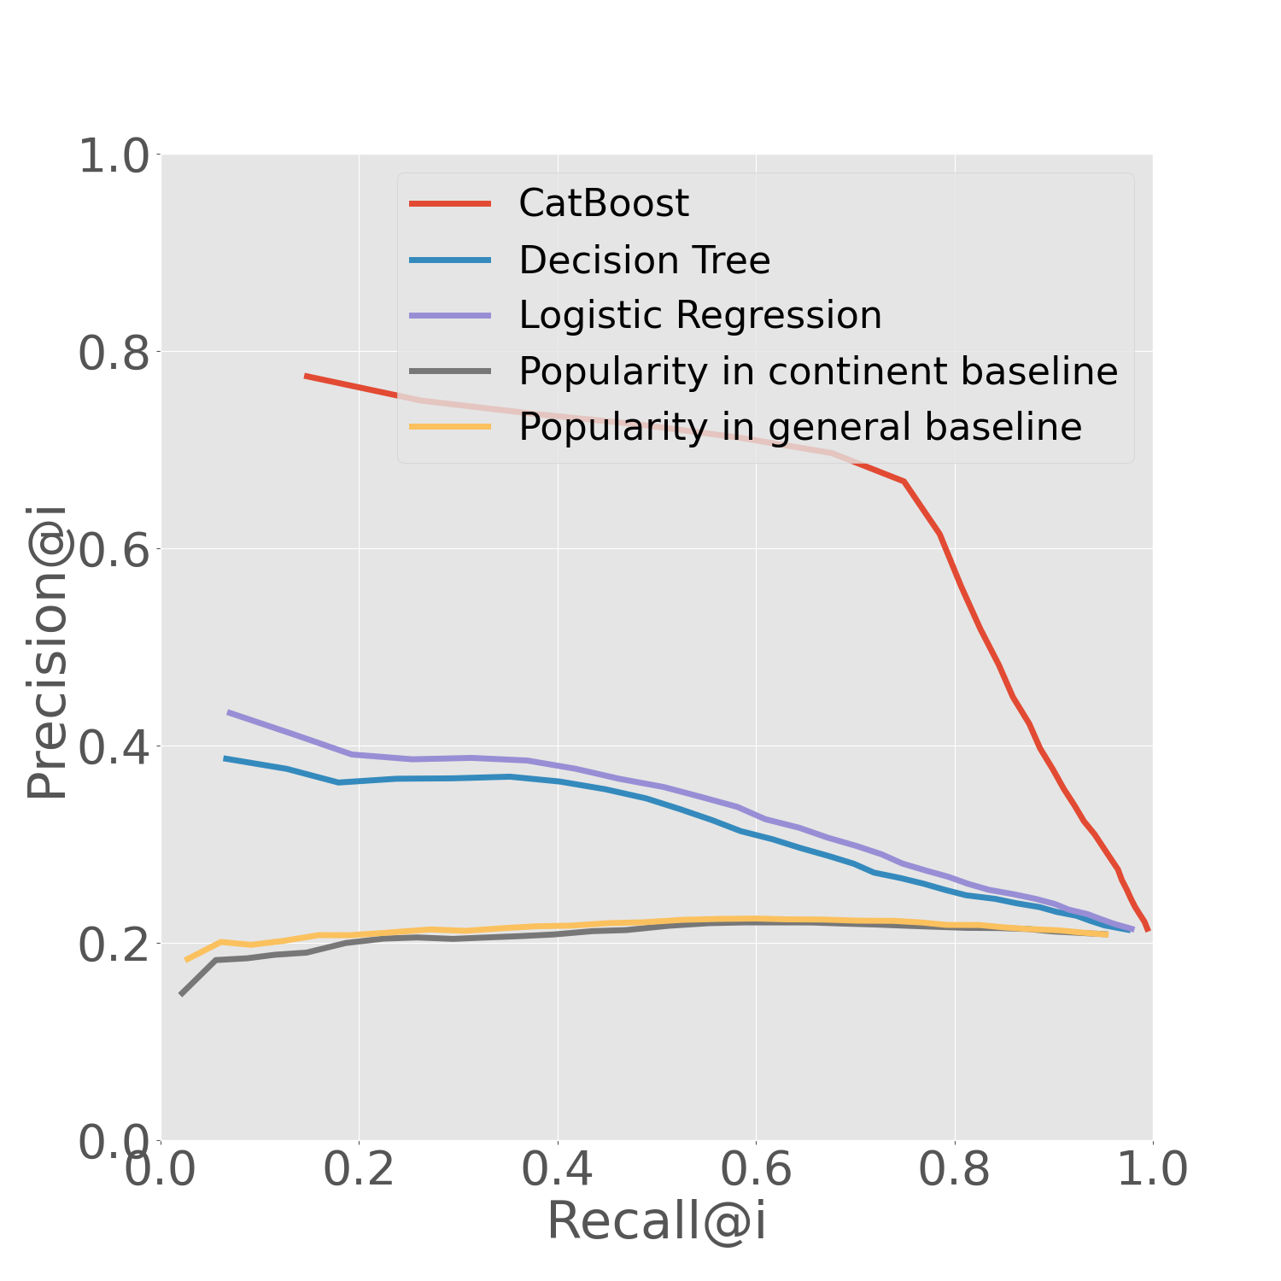

Results – Training Peaks and STRAVA Data Israel - Premier Tech
Data Imputation - PR
Classifiers - PR
Classifiers – R@(n+k)
Training
Peaks
STRAVA
Notes:
The thresholds for creating the PR graphs defined as I (number of cyclists recommanded)
Don’t forget to say the values of PR and R@(n+k)

Slide 19
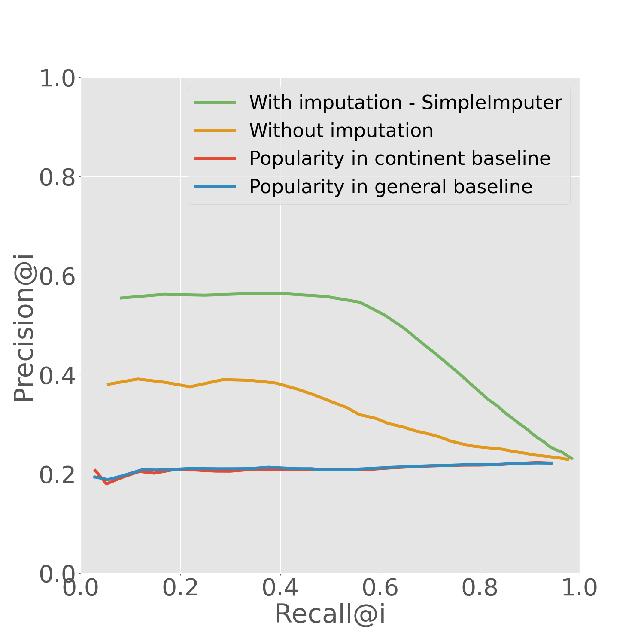
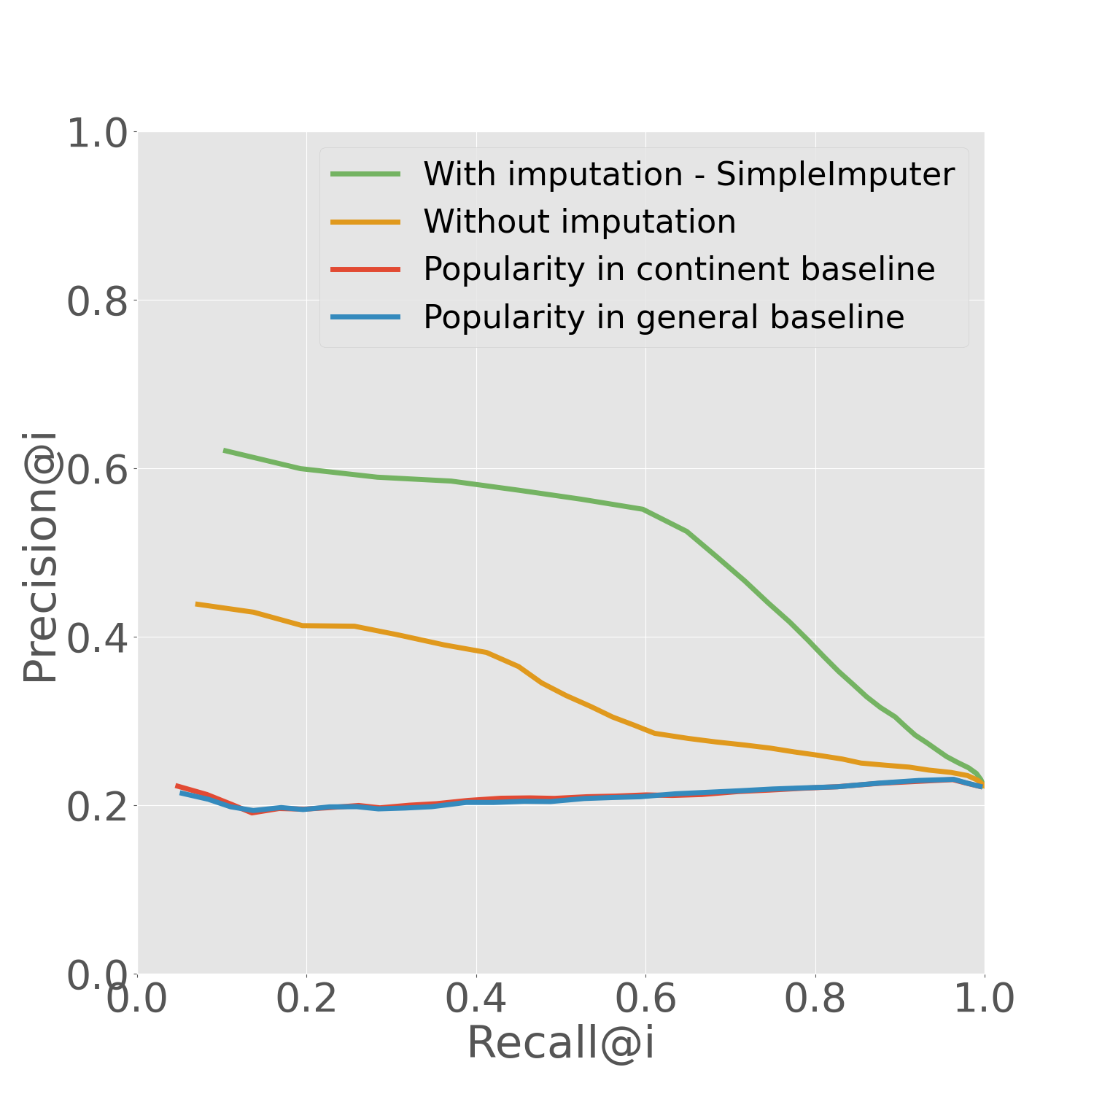
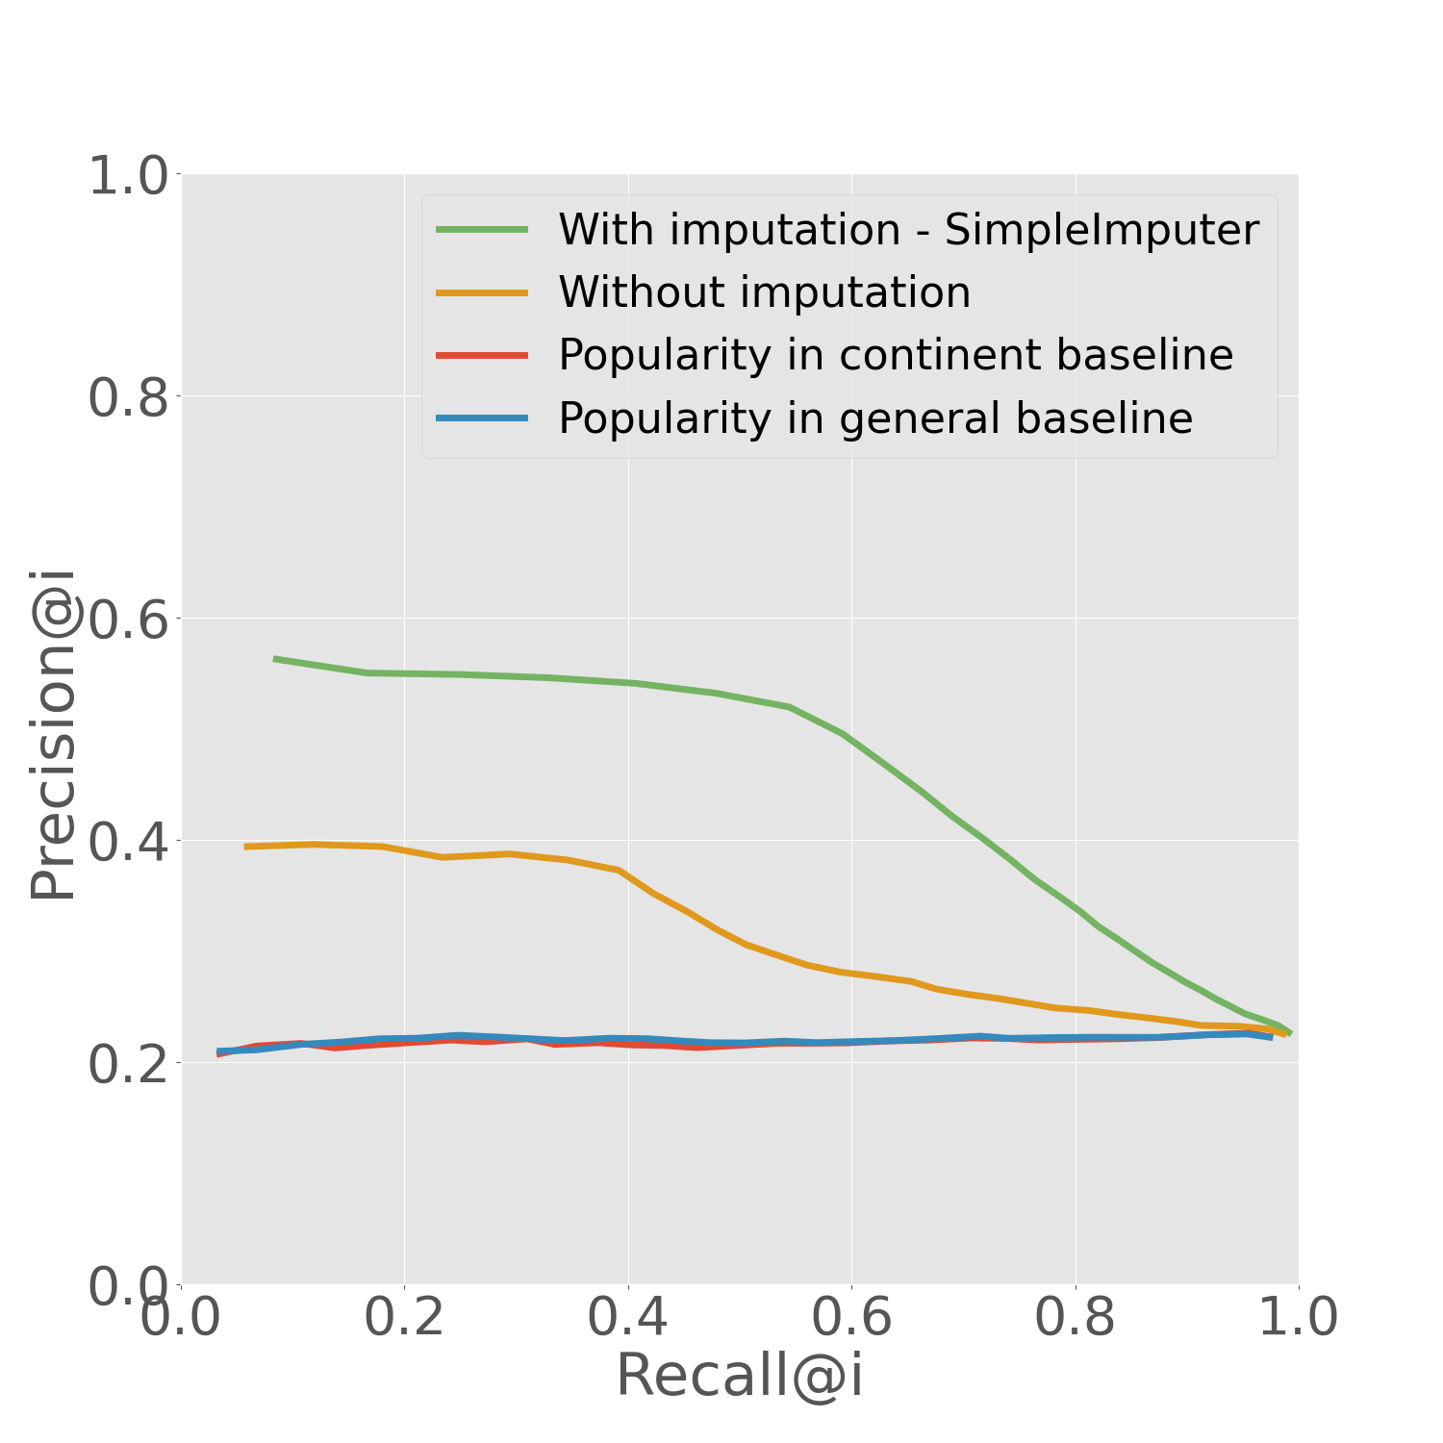
Imputation Results – STRAVA Data
AG2R Citroën Team
Israel - Premier Tech
Groupama - FDJ
Jumbo-Visma

Slide 20
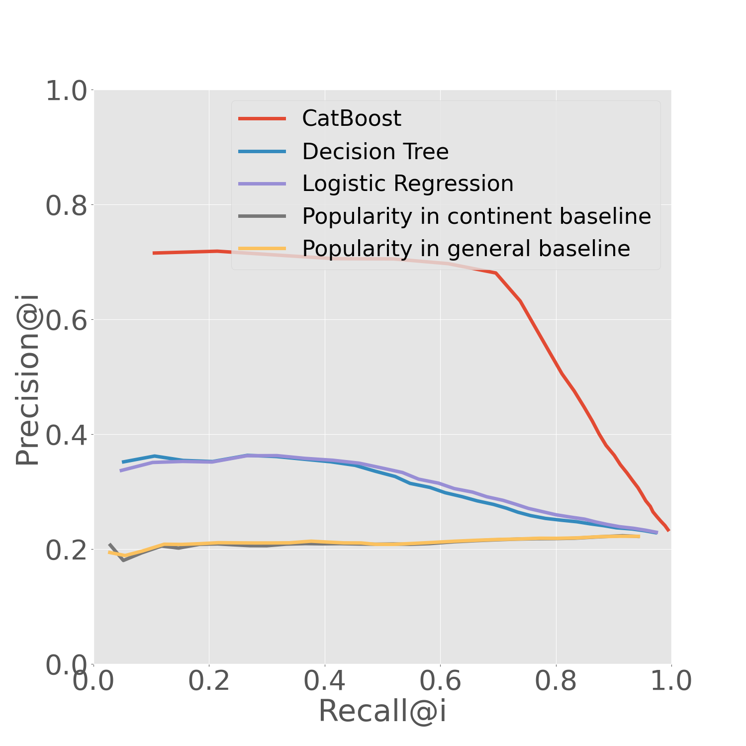
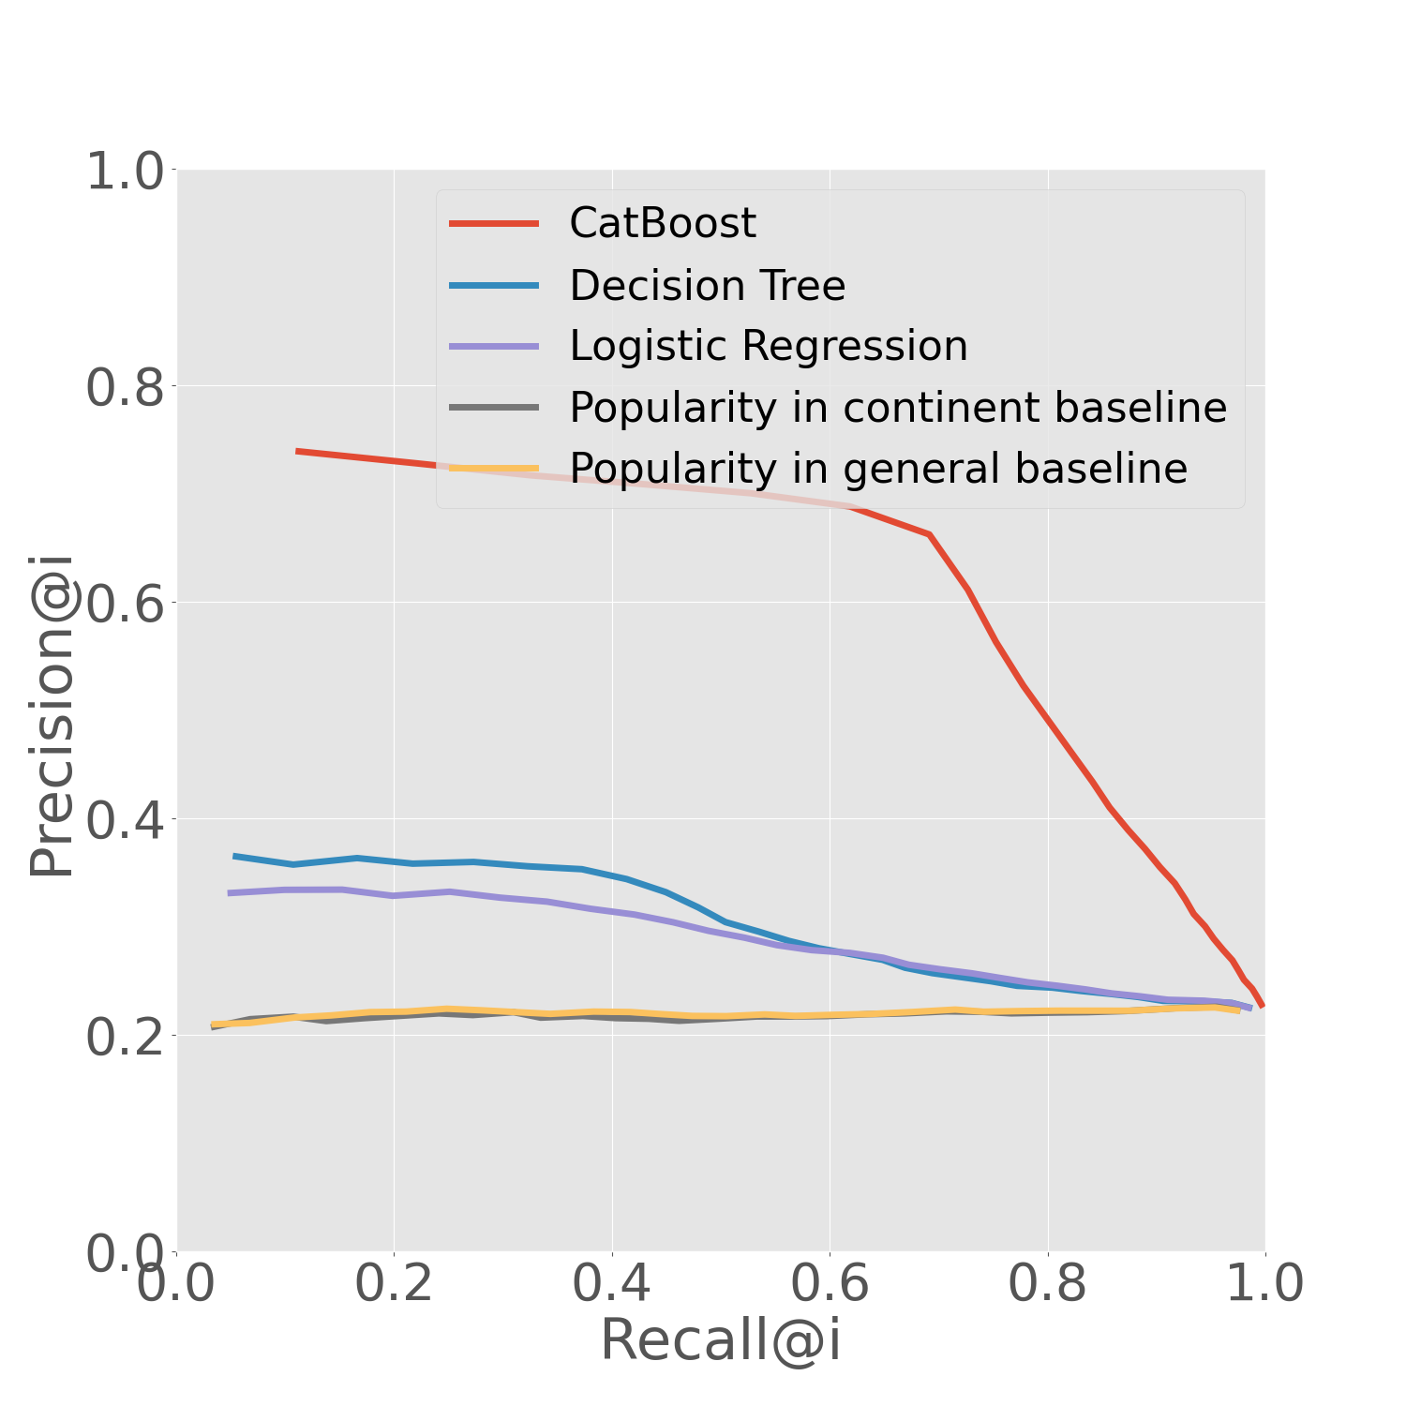
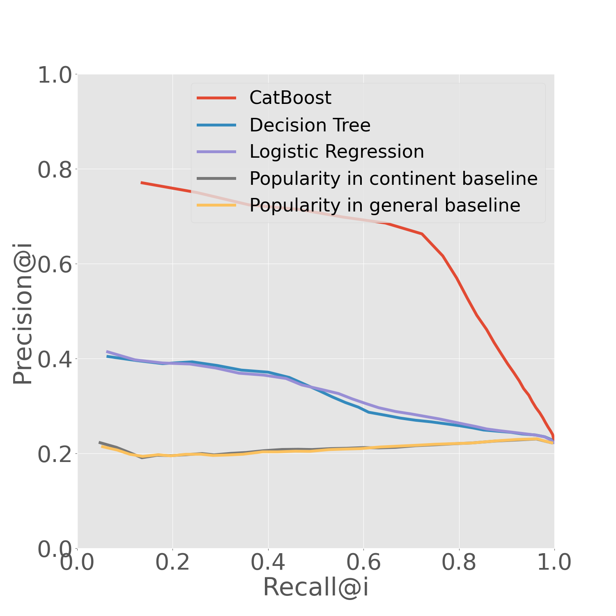
Classifier Results – STRAVA Data
AG2R Citroën Team
Israel - Premier Tech
Groupama - FDJ
Jumbo-Visma

Slide 21
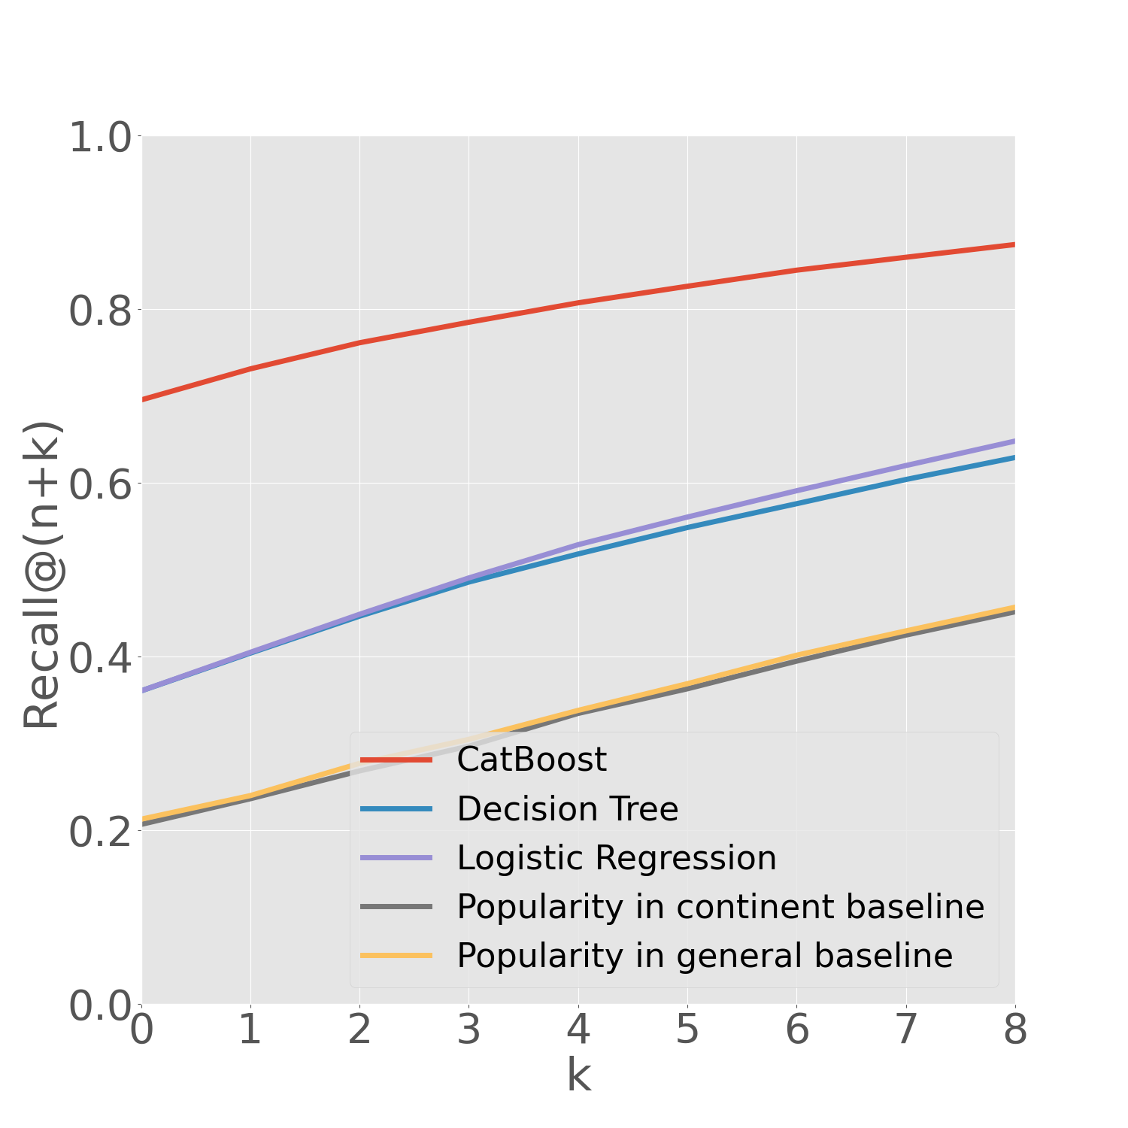
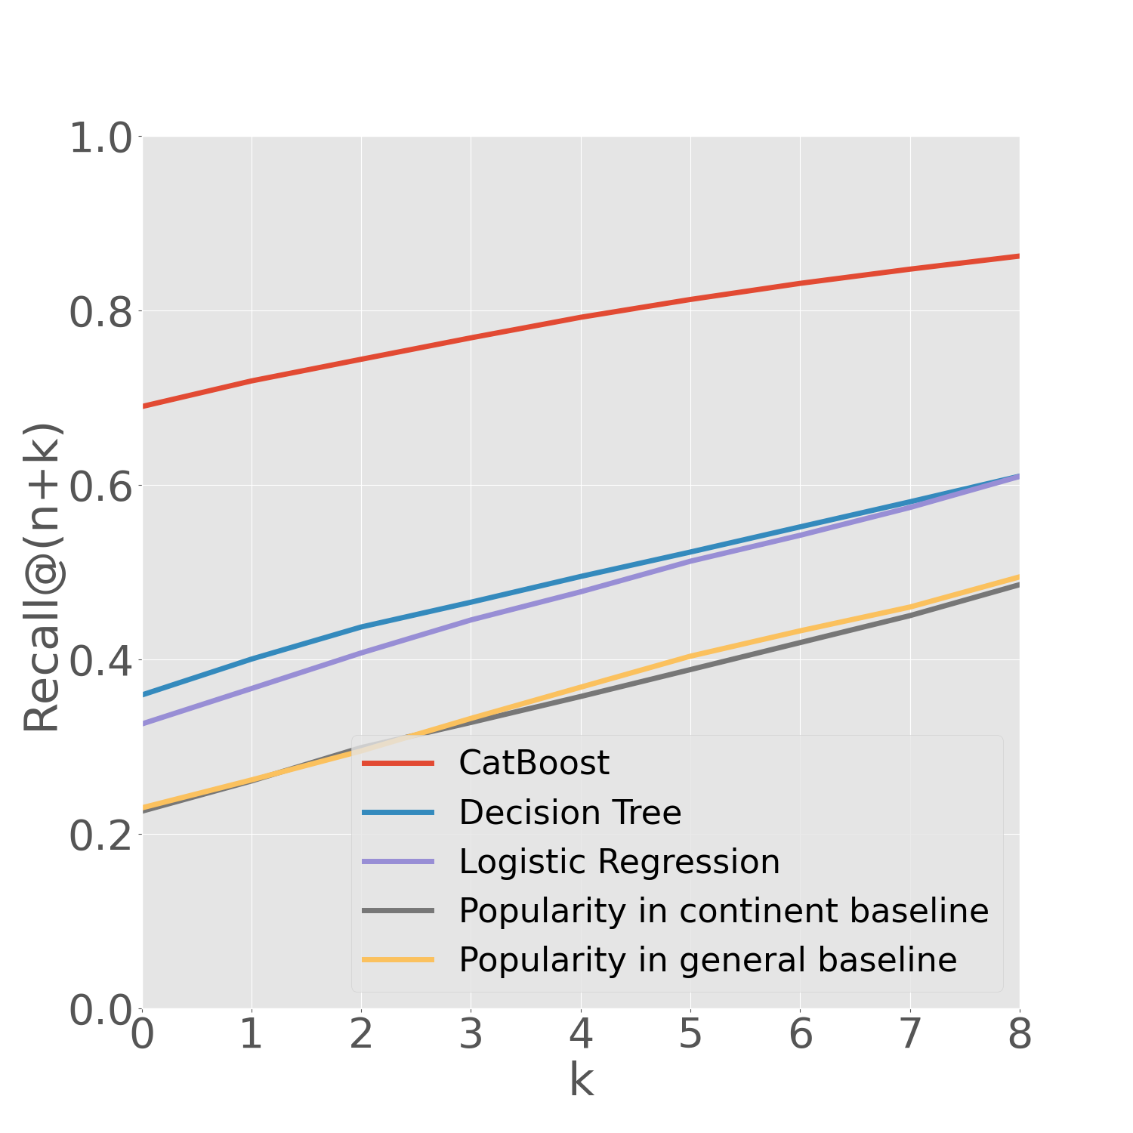
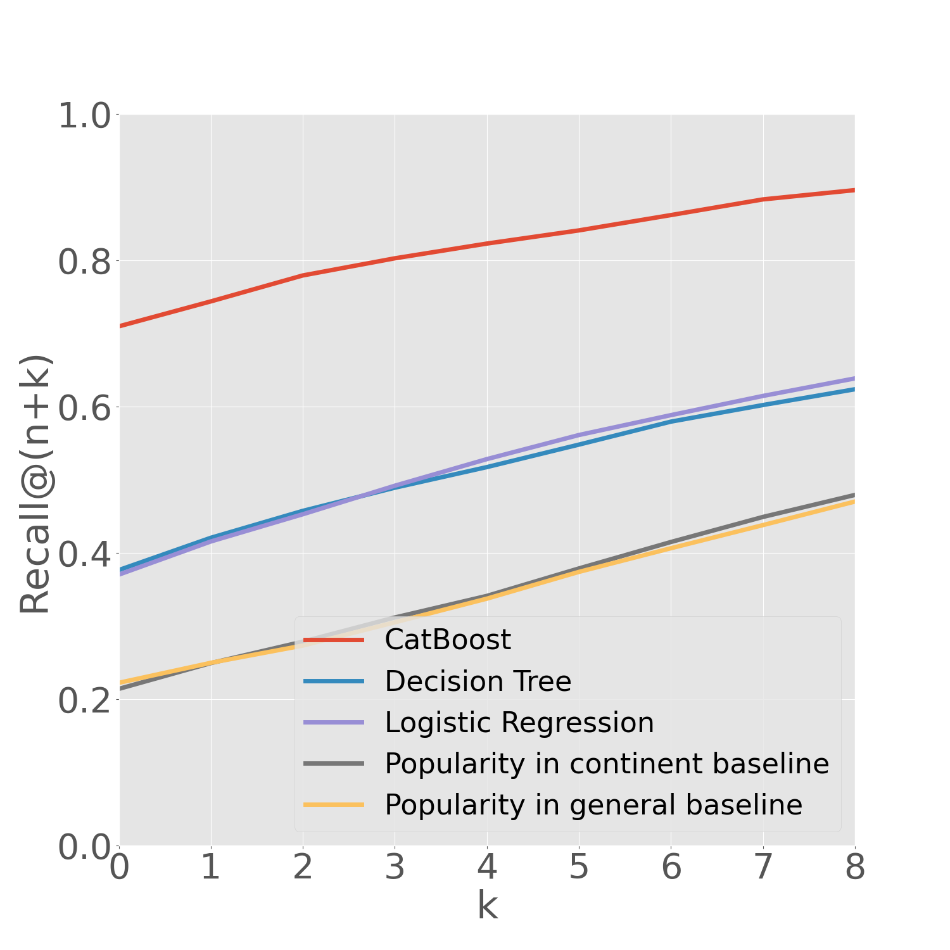
Classifier Results – STRAVA Data
AG2R Citroën Team
Israel - Premier Tech
Groupama - FDJ
Jumbo-Visma

Slide 22
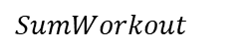
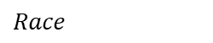
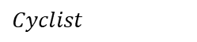
Feature Importance Analysis Israel - Premier Tech - Training Peaks Data
Feature Group:
$$Cyclist$$
$$Race$$
$$SumWorkout$$
Feature Importance
Shap
CatBoost
Relief
Information Gain
Chi Square
Most important
Less important
Model Based
Data Driven
Notes:
Chi = קאי
Information gain / mutual information + chi2 =>for categorical (classification tasks)
IG - a measure of how much information a feature provides about a class
MI-information gain can also be used for feature selection, by evaluating the gain of each variable in the context of the target variable. In this slightly different usage, the calculation is referred to as mutual information between the two random variables.
Mutual information calculates the statistical dependence between two variables and is the name given to information gain when applied to variable selection.
Chi squared - A chi-square test is used in statistics to test the independence of two events. Given the data of two variables, we can get observed count O and expected count E. Chi-Square measures how expected count E and observed count O deviates each other.
Relief – originally for binary classification problems. Iterative method - Relief feature scoring is based on the identification of feature value differences between nearest neighbor instance pairs. If a feature value difference is observed in a neighboring instance pair with the same class (a 'hit'), the feature score decreases. Alternatively, if a feature value difference is observed in a neighboring instance pair with different class values (a 'miss'), the feature score increases.
https://towardsdatascience.com/using-the-chi-squared-test-for-feature-selection-with-implementation-b15a4dad93f1

Slide 23
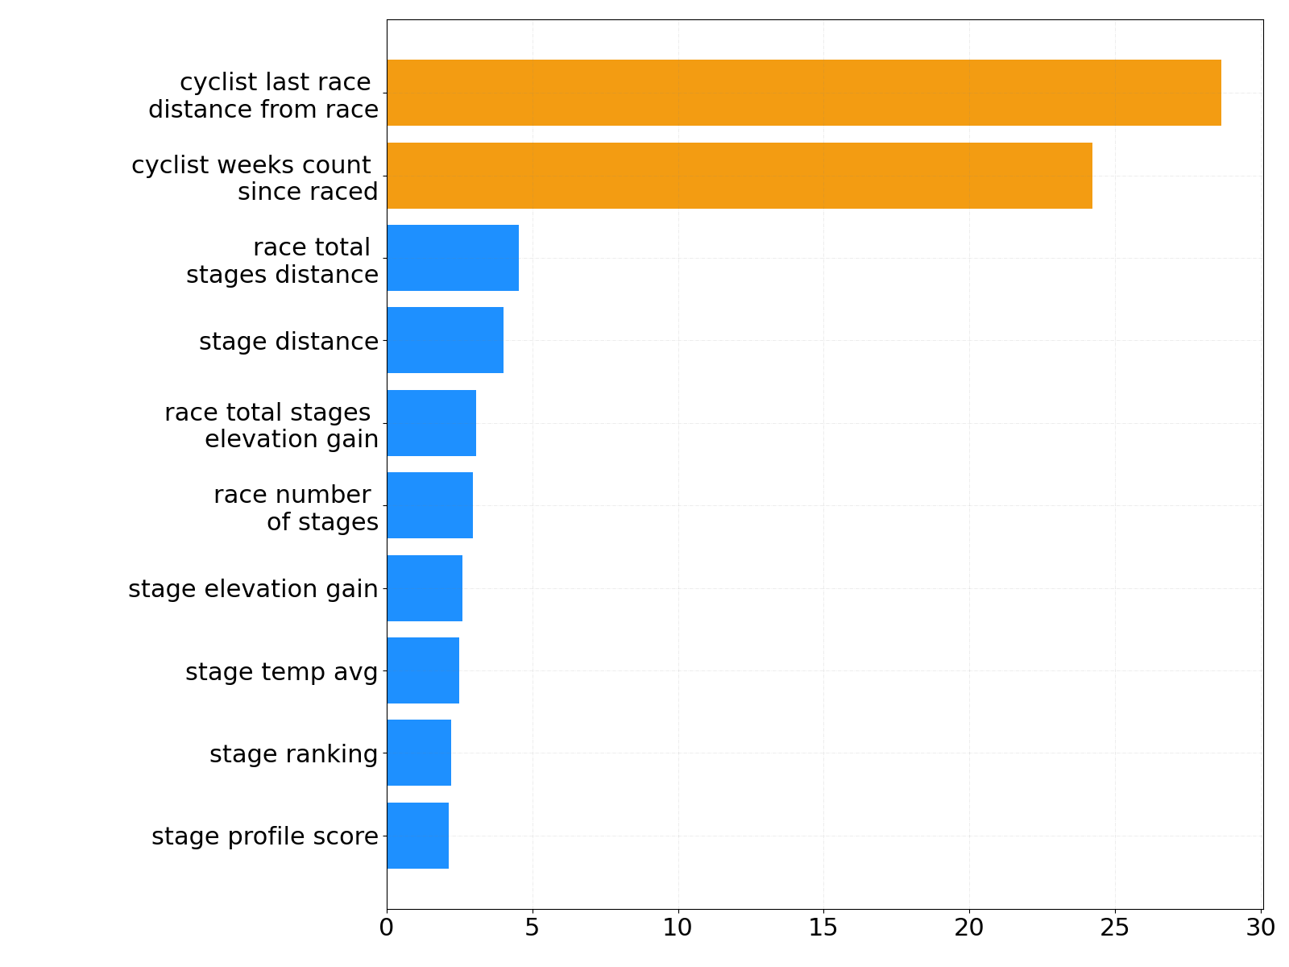
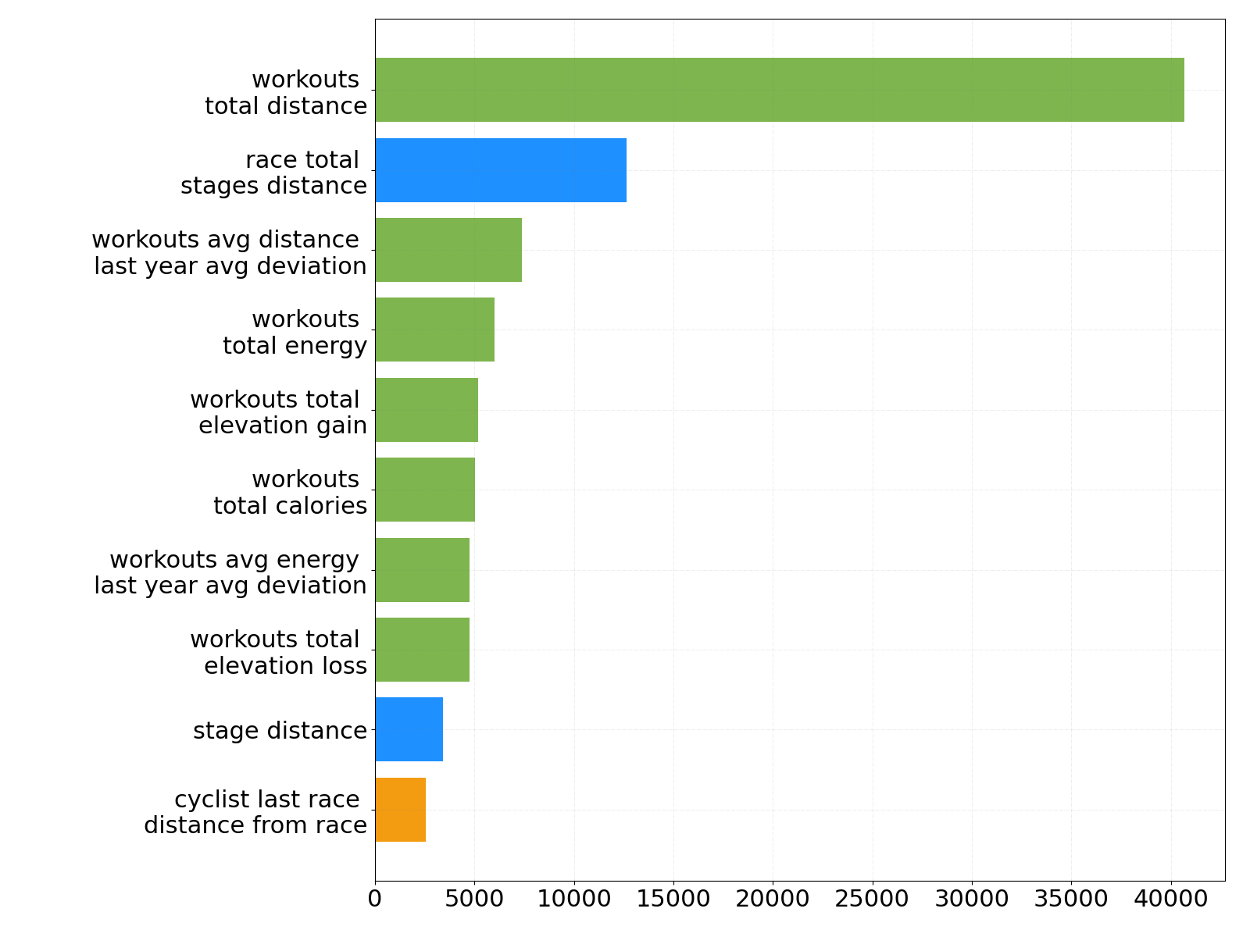



Feature Importance Analysis Israel - Premier Tech - Training Peaks Data
Feature Group:
$$Cyclist$$
$$Race$$
$$SumWorkout$$
Model Based
Data Driven
CatBoost
Relief
Chi Square
Shap
Information Gain

Slide 24




Feature Importance Analysis Relief – STRAVA Data
Feature Group:
$$Cyclist$$
$$Race$$
$$SumWorkout$$
AG2R Citroën Team
Israel - Premier Tech
Groupama - FDJ
Jumbo-Visma

Slide 25
Summary
RaceFit, a classification based ranking to model coaches’ cyclists allocation to races
Evaluation on multiple cycling teams seem to perform similarly. The use of imputation and the CatBoost performed best
Feature Importance: data driven rankers show that the ‘workouts summary’ properties are more important, while in the model based it’s the cyclists and races properties are more influential

Slide 26
Thank You!
M.Sc. Maor Sagi
Complex Data Analytics Lab
Software and Information Systems Engineering
Ben-Gurion University
Israel
maos@bgu.ac.il

Slide 27




Feature Importance Analysis Information Gain – STRAVA Data
Feature Group:
$$Cyclist$$
$$Race$$
$$SumWorkout$$
AG2R Citroën Team
Israel - Premier Tech
Groupama - FDJ
Jumbo-Visma

Slide 28




Feature Importance Analysis Chi Square – STRAVA Data
Feature Group:
$$Cyclist$$
$$Race$$
$$SumWorkout$$
AG2R Citroën Team
Israel - Premier Tech
Groupama - FDJ
Jumbo-Visma

Slide 29




Feature Importance Analysis Shap – STRAVA Data
Feature Group:
$$Cyclist$$
$$Race$$
$$SumWorkout$$
AG2R Citroën Team
Israel - Premier Tech
Groupama - FDJ
Jumbo-Visma

Slide 30




Feature Importance Analysis CatBoost – STRAVA Data
Feature Group:
$$Cyclist$$
$$Race$$
$$SumWorkout$$
AG2R Citroën Team
Israel - Premier Tech
Groupama - FDJ
Jumbo-Visma

Slide 31
Races per Team
4 UCI World Teams –
Team | # Races | # Stages | # Examples
Israel - Premier Tech | 463 | 1388 | 39k
Jumbo-Visma | 355 | 1304 | 36k
Groupama - FDJ | 429 | 1371 | 40k
AG2R Citroën Team | 469 | 1434 | 43k

Slide 32


